Slide 1
Data Analytics Assessment
Gbemisola Abolade

Slide 2


AGENDA
Question 1
Question 2
Question 3
Question 4
Question 5
Insights
Recommendations
summary

Slide 3
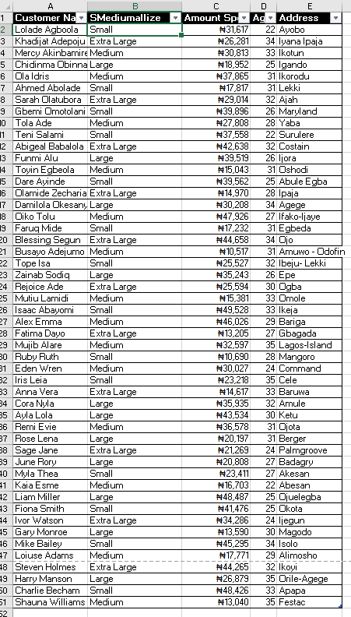
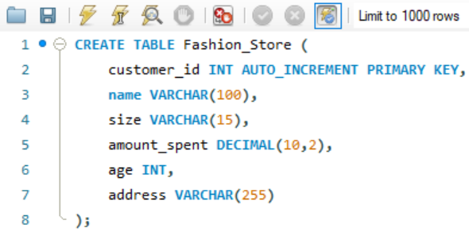
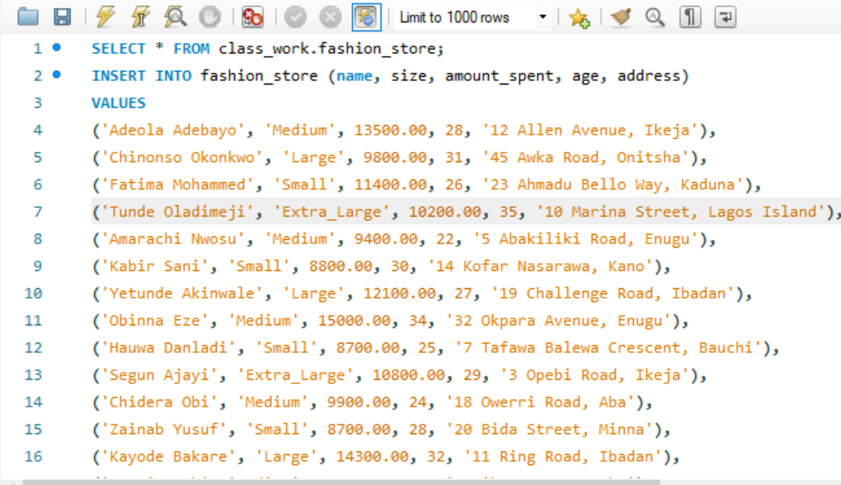
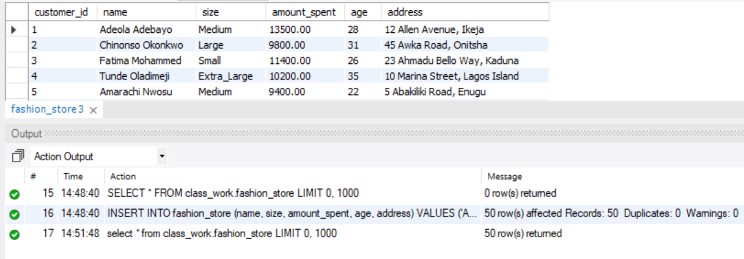
Question 1

Slide 4
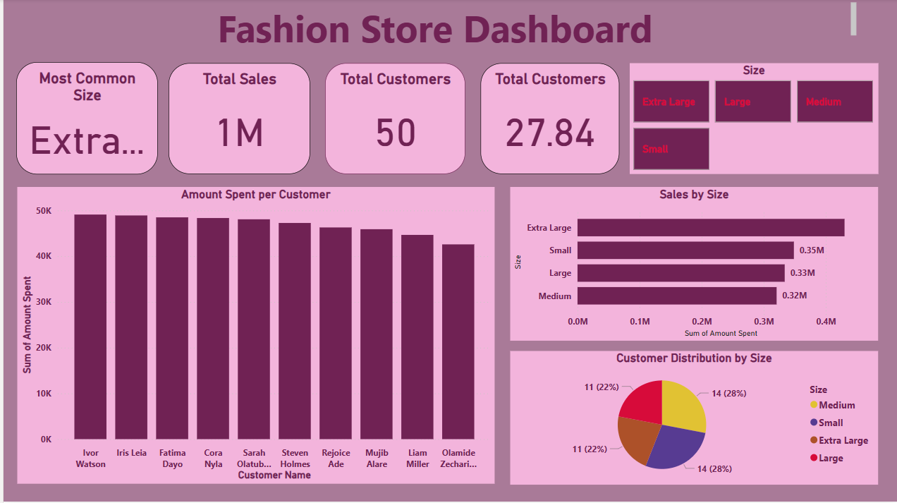
QUESTION 2

Slide 5
QUESTION 3
SQL (Structured Query Language): A language used to manage and manipulate databases.
Database: A collection of structured information stored electronically.
DBMS (Database Management System): Software that interacts with users and databases
to manage data (e.g., MySQL, PostgreSQL).
Worksheet: A single spreadsheet within an Excel file where data is entered, analyzed, and visualized.

Slide 6
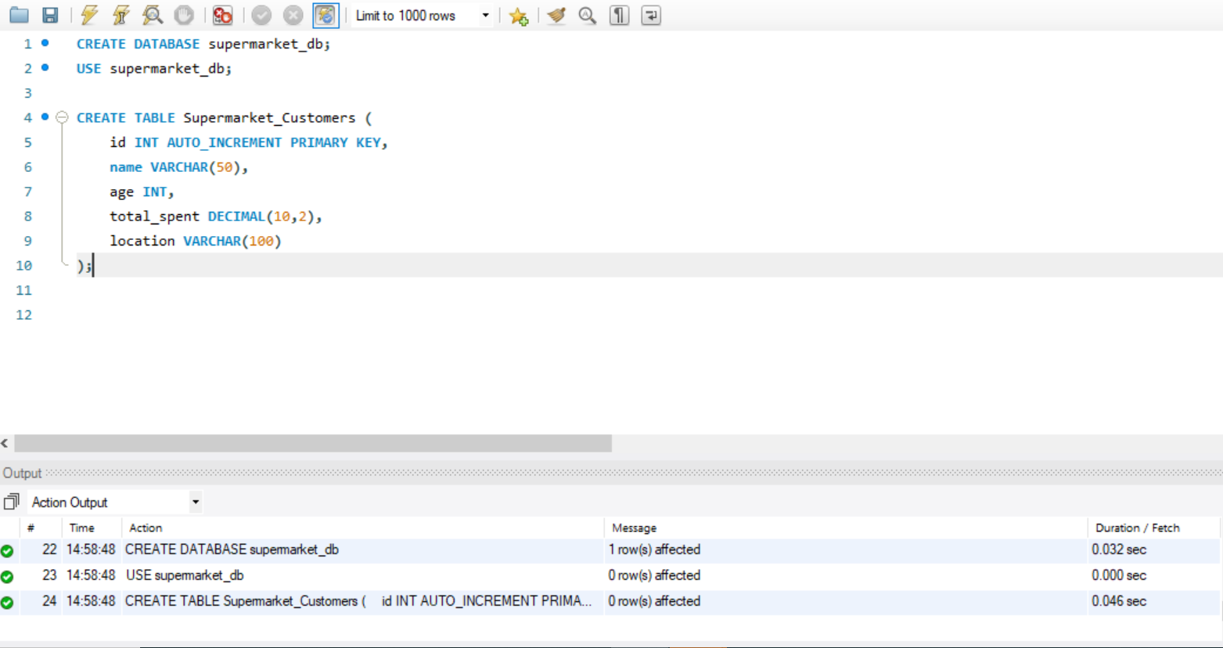
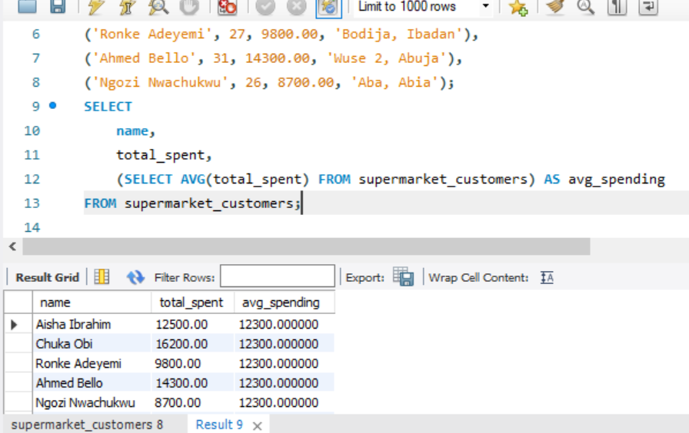
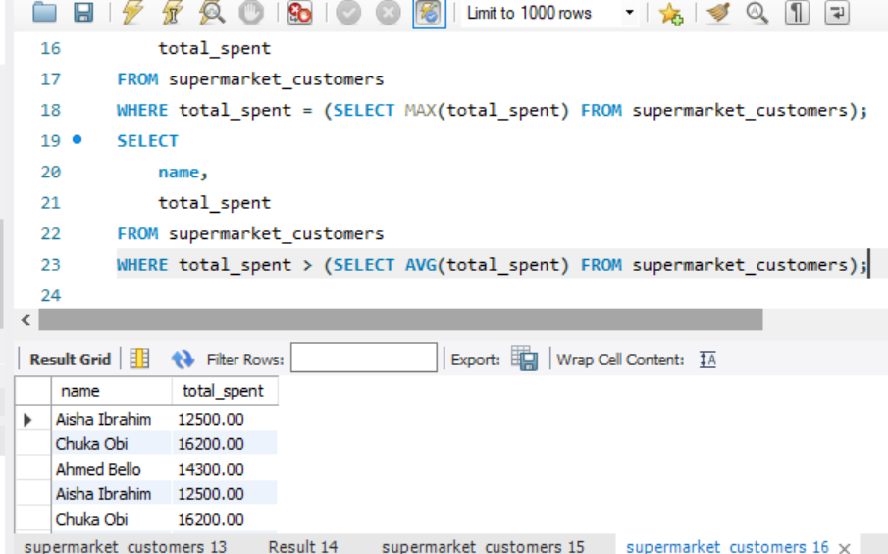
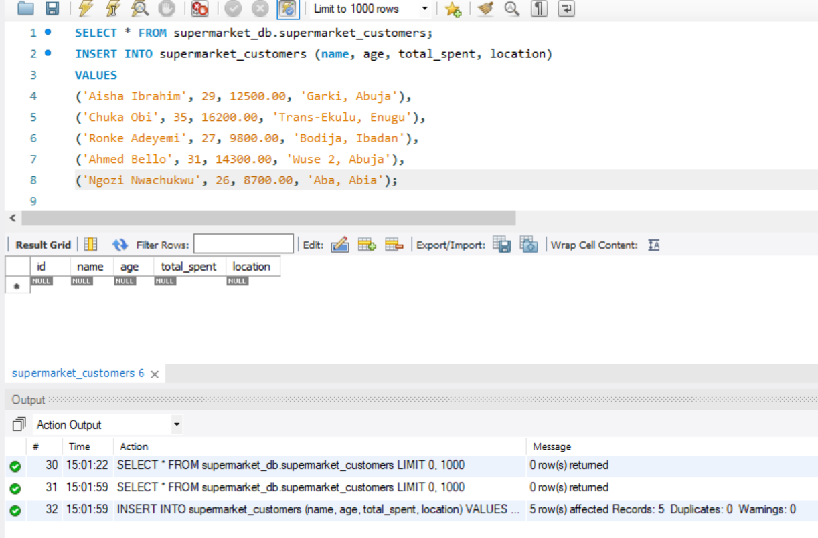
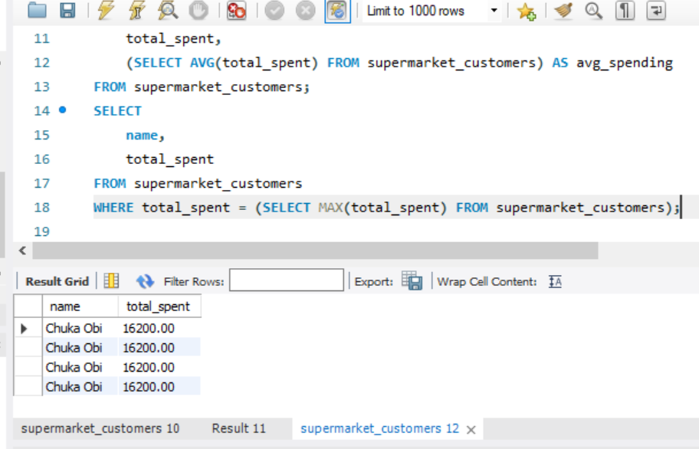
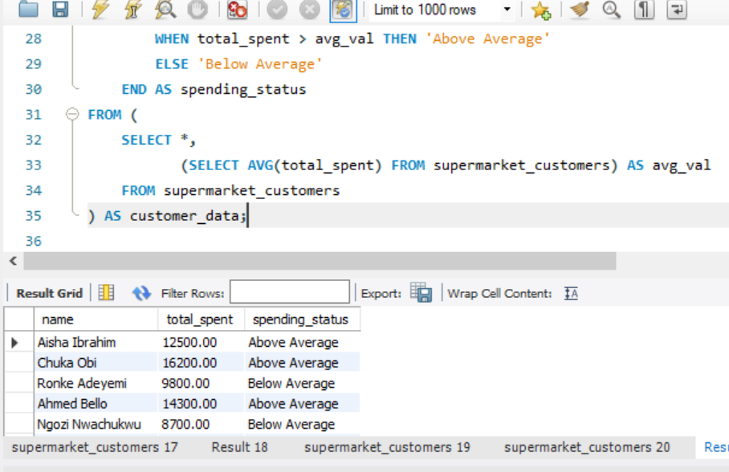
Question 4

Slide 7
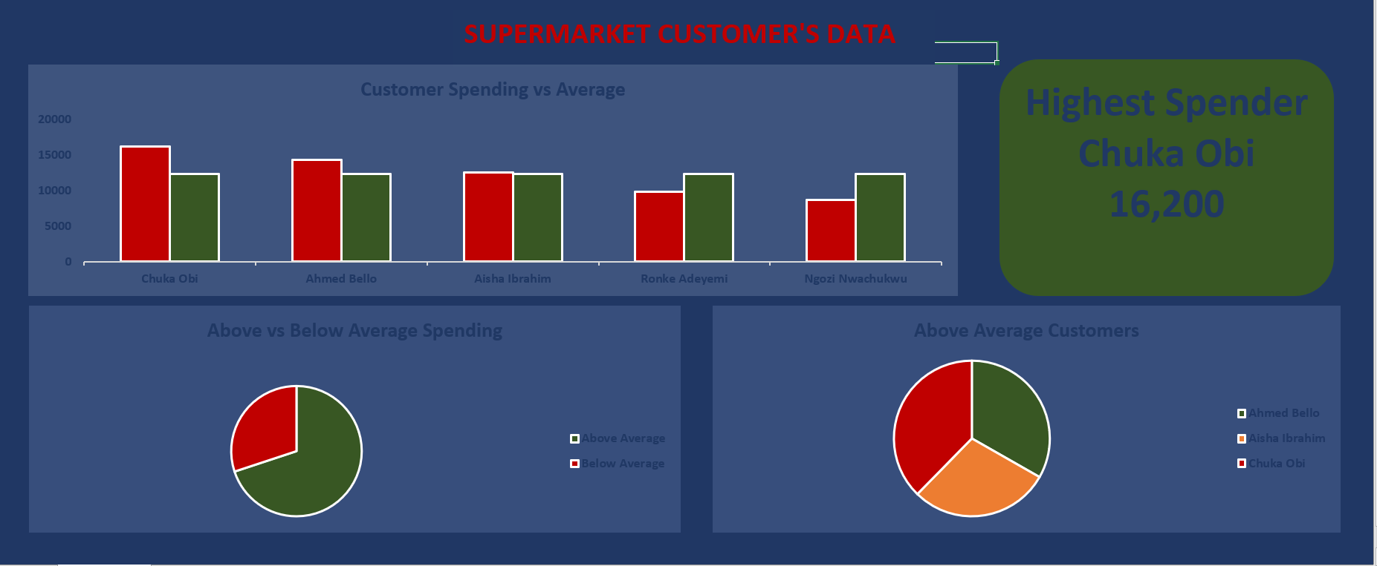
Question 5

Slide 8
Insights
Supermarket Customer Data (5 Customers with Subqueries)
Above-Average Spenders:
Subquery results show 3 out of 5 customers spent above the average ₦12,700.
These individuals were clustered around age 29–35.
Spending Status Classification:
Pie chart visualizes the breakdown: 60% of customers were "Above Average" spenders, with 40% labeled "Below Average."
This segmentation highlights spending tiers that can inform marketing strategy.
Highest Spender Identified:
A KPI card highlights Chuka Obi as the top spender at ₦16,200.
Important for identifying high-value customers in smaller datasets.
Sales Share Pie Chart:
Spending distribution shows a concentration of sales in a few hands, echoing the fashion dataset’s trend at a smaller scale.
Fashion Store Customer Data (50 Customers)
Popular Sizes:
Sizes Medium and Large made up the highest portion of sales, as seen in the size distribution chart.
Indicates that customers commonly fall within mid-range size categories.
Spending Trend:
A bar chart shows that a few individual customers made significantly higher purchases, showing a typical 80/20 revenue pattern.
These top spenders may be targeted for premium offerings or loyalty rewards.
Age Distribution vs Spending:
Customers between 27 and 35 years spent the most on fashion items.
Younger customers (below 25) had lower average spending.

Slide 9
RECOMMENDATIONs
Supermarket Customer Data (Subquery Analysis)
Segment Customers Based on Spending Behavior
Use insights from subqueries (Above/Below Average) to personalize offers for each group—discounts for lower spenders, loyalty perks for higher spenders.
Identify and Nurture Top Spenders
Customers like Chuka Obi, who spend significantly more, should be flagged for special treatment, feedback collection, or reward programs.
Replicate the Model Store Setup in High-Spending Locations
If spending correlates with specific locations, consider expanding store presence or improving service in those regions.
Fashion Store Customer Data
Optimize Inventory for Medium and Large Sizes
Focus stock and purchasing around M and L sizes to meet majority demand and reduce dead stock of less popular sizes.
Implement Targeted Marketing Campaigns by Age
Launch promotions targeting customers aged 27–35, as they represent the highest spenders.
Focus Sales Strategy on Urban Centers
Prioritize marketing efforts and in-store events in cities like Lagos, Abuja, and Ibadan where customers spend more.
Introduce Loyalty Rewards for Top Spenders
Create VIP or loyalty tiers for high-value customers to encourage repeat purchases and brand loyalty.

Slide 10
SUMMARY
This assessment demonstrated a comprehensive approach to data analytics, utilizing Excel, MySQL, and Power BI to analyze customer behavior in both a fashion store and a supermarket.
Fashion Store Customer Data:
Insights from the fashion store dataset focused on size preferences, spending habits, and age demographics. Key findings revealed a high demand for Medium and Large sizes and a higher spending trend among customers aged 27–35. Spending was more concentrated in urban centers such as Lagos and Abuja.
2. Supermarket Customer Data:
The supermarket dataset, analyzed using subqueries in SQL, provided detailed insights. Subqueries were used to:
Identify customers who spent above average by using the AVG() function
Segment customers as Above Average and Below Average spenders using the CASE statementin a subquery.
These subqueries enabled effective segmentation, helping us better understand spending behavior even with a small dataset.
Actionable Recommendations:
For the fashion store, prioritize stocking Medium and Large sizes and target marketing towards customers aged 27–35. For the supermarket, focus on engaging top spenders using loyalty programs and segmenting campaigns based on spending levels.
By integrating SQL subqueries and data visualizations, this assessment highlights the importance of leveraging structured data for business decision-making.

Slide 11
THANK YOU
Gbemisola Abolade
gbemisolaomotolani@gmail.com

